Slide 1

IFFCO-MC Hackathon 2022
TEAM ZEUS
Sourish Chatterjee
Sanyog Sharma
Nitish Kumar
Akhil Kumar Donka

Slide 2
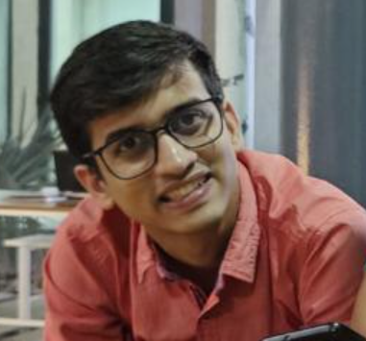
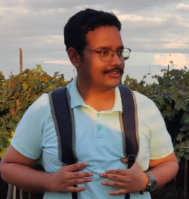
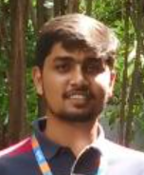
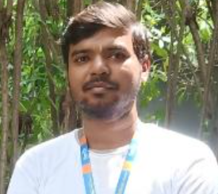
Team Zeus
Sanyog Sharma
Master Student in IITH
Department of AI
Sourish Chatterjee
Masters Student at IITH
Department of Electrical Engg
Akhil Kumar
Master Student at IITH
Department of Electrical Engg
Nitish Kumar
Master Student at IITH
Department of Electrical Engg

Slide 3
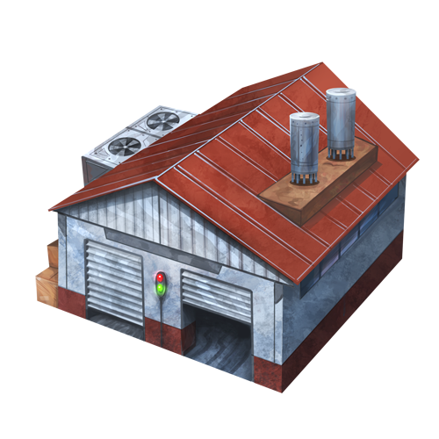




Problem Statement?
1
Order to IFFCO-MC
IFFCO-MC ask C&F
2
Channel and Forwarding
Transport to Retailer/CP/FCP etc
Retailer/CP/FCP etc
No Digital Tracking
No Digital Tracking but OK to Handle?

Slide 5



IFFCO MC Backend Web Server
Customer
Whatsapp Business Account

Slide 6
User Segment & Pain Points
Which user /advertiser segment would be early adopter of your product & why?

Slide 7
Pre-Requisite
What are the alternatives/competitive products for the problem you are solving?

Slide 8
Tools or resources
Tools or resources which are likely to be used by you for the prototype, if your idea gets selected

Slide 9
Any Supporting Functional Documents
Present your solution, talk about methodology, architecture & scalability

Slide 10
Key Differentiators & Adoption Plan
How is your solution better than alternatives and how do you plan to build adoption?

Slide 11
How far it can go?

